Slide 1

pipeline for single-cell analysis

Slide 2
Motivation
These improvements in microscopy have motivated the need for automated image analysis, as traditional approaches that require manual error correction cannot keep pace with the size of these new datasets or the rate at which they can be acquired.
To address this, researchers need tools that are rapid, accurate, and require minimal input from the user. This combination of needs is well suited for deep learning-based approaches, and deep convolutional neural networks have enabled fast and accurate analysis of images.
The automation of hardware and software for microscopy has resulted in researchers’ ability to generate massive datasets containing images of cells over time.
Two-dimensional environments are straightforward to implement experimentally

Slide 3
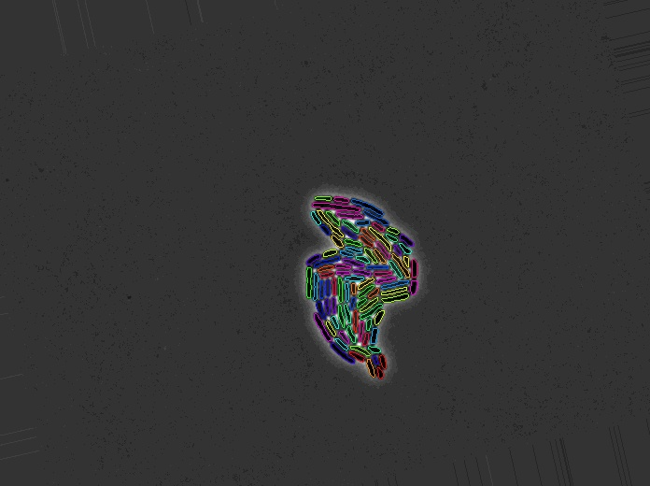
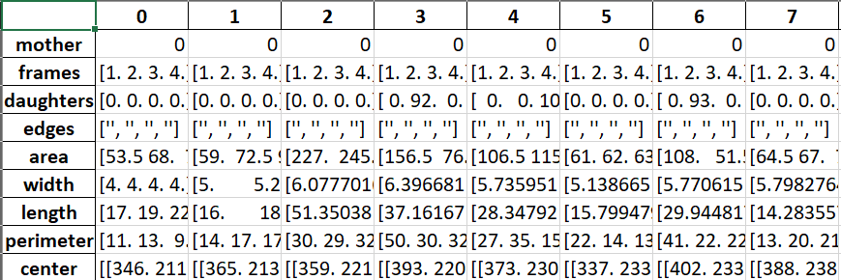
Capability
Segmentation generates information about cell morphology
The tracking step reliably tracks cells across frames, recording division events when they occur
This application can track cell length, growth rate, fluorescence, and progeny over time for cells growing in a two-dimensional microcolony. The algorithm takes microscopy images as inputs. It then uses two U-Net convolutional neural network models, one for segmentation and one for
tracking, and outputs single-cell data.

Slide 4

Implementation
The loss function determines the difference between the model output and the ground truth which is then used to update the weights within the model loss function takes a weight map as an extra input to assign more importance to certain pixels in the ground truth during training.
Custom weight maps were used to improve segmentation on rod-shaped bacteria by increasing weights for the center of the cells and the borders between the cells. Weight is minimised on the background, where background is defined as anything in the image that is not a cell or border
The U-Nets are implemented in TensorFlow/Keras.

Slide 5
Implementation
The model outputs a number between 0 and 1, with 0 representing the background and 1 representing a cell.
If the model incorrectly predicted a cell for a pixel that is background, then there would be a high value for that pixel in the weight map. Alternatively, if the model correctly
predicted background for a pixel that was background, then there would be a low value for that pixel in the weight map.
Determining the exact borders of the cells by eye is hard and partially arbitrary. To prevent the model from learning these arbitrary cell-border interfaces, the weights in these areas were reduced.
In addition, the background weights
were set to be variable, where the weight increased with respect to an incorrect prediction.

Slide 6
Implementation
To train the segmentation network a pixel-wise weighted binary cross-entropy loss function as described in the original U-Net paper is implemented to enforce border detection between cells, as well as an extra step that sets the weight to zero around the 1-pixel contour of the cells.
By doing so, constraint on learning of the exact contour as provided in the segmentation masks in the training set is relaxed. This makes the model more generalisable, as the algorithm does not have to exactly fit the output of
the training image set segmentation.
The tracking model uses a sigmoid function as the final activation layer and a pixelwise-weighted binary cross-entropy loss function to produce a single grayscale output image with 1’s representing tracked cells (mother and potential daughter) and 0’s
representing the background and the cells that did not track to the input cell.

Slide 7
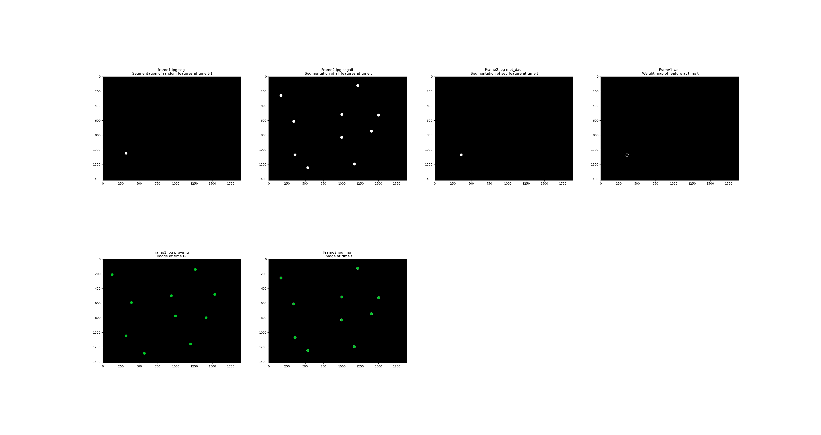
Implementation
Data augmentations were used while training the segmentation model, such as Gaussian blurring, Gaussian noise, skewing, shifting, and colour alternations.
Additionally, a separate program was developed that could generate workable datasets from a smaller set of data – for both segmentation and tracking.
This allowed for rapid development of training data and, therefore, rapid training, testing, and evaluation.

Slide 8
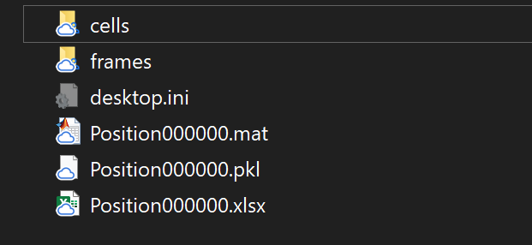
Results
The program outputs several different results after the pipeline is completed: individual frame images (cell IDs, cell count per frame, and cell outlines), individual cell images, MATLAB data file, python PICKLE file, Excel data file, and video output file.

Slide 9
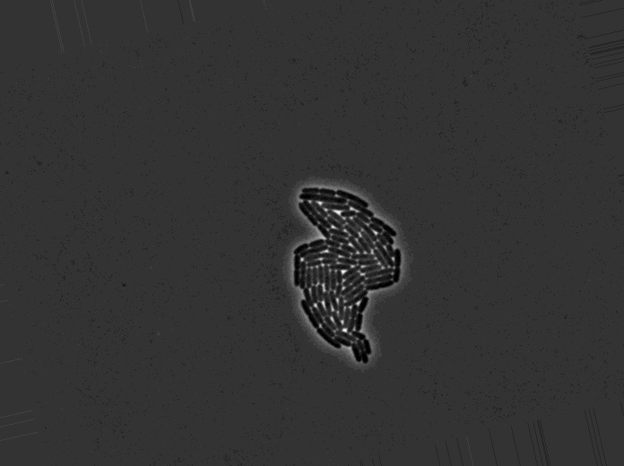

Results
These show the original frame and the generated segmentation image.

Slide 10
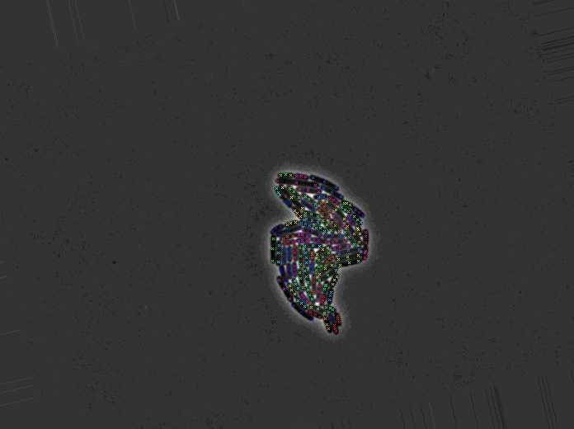
Results
This output shows the ‘poles’ for each cell, these are the foci which are generated during mitosis (cell division).

Slide 11
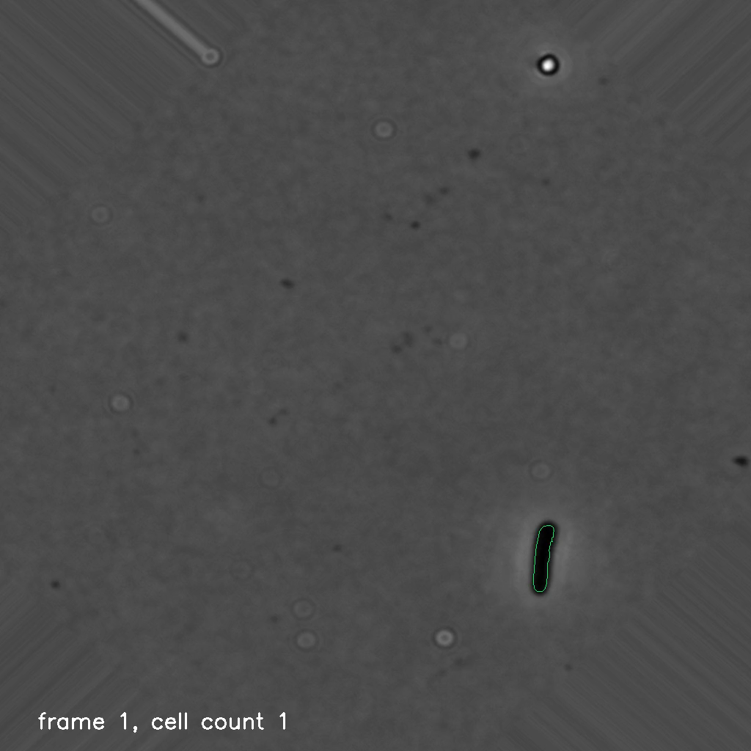
Results
This video output shows the original frames with the addition of a coloured contour around each cell, a white arrow indicating mitosis direction, and a text overlay showing frame number and cell count in that frame.

Slide 12
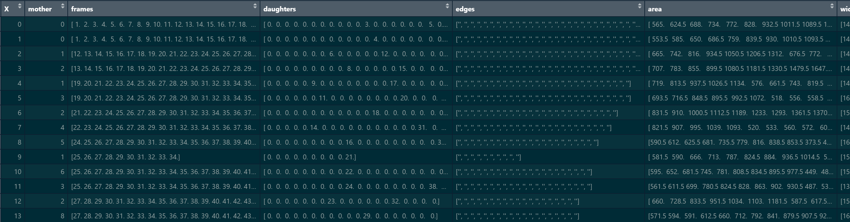
Results – r analysis
As one of the output formats for the result is an Excel file, it is possible to then use this for further analysis.
When imported into RStudio we have the below data to play with.

Slide 13
Results – r analysis
As an example of the type of analysis we can perform using R we will look at the length of the cells.
The length of a cell changes over time as it undergoes growth, division, and then growth again.

Slide 14
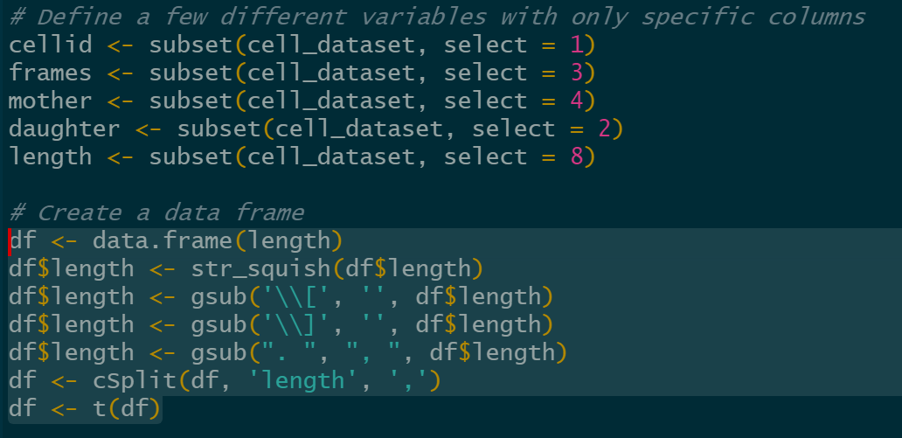
Results – r analysis
To begin we split our data up based on particular columns we may be interested in.
We then create a new data.frame object from our ‘length’ variable’. This has to be tidied up a bit as there are characters from our original Python variables that were written to the Excel file. So we remove errant dots and commas, and then finally split the length string into separate lengths per frame variables.

Slide 15
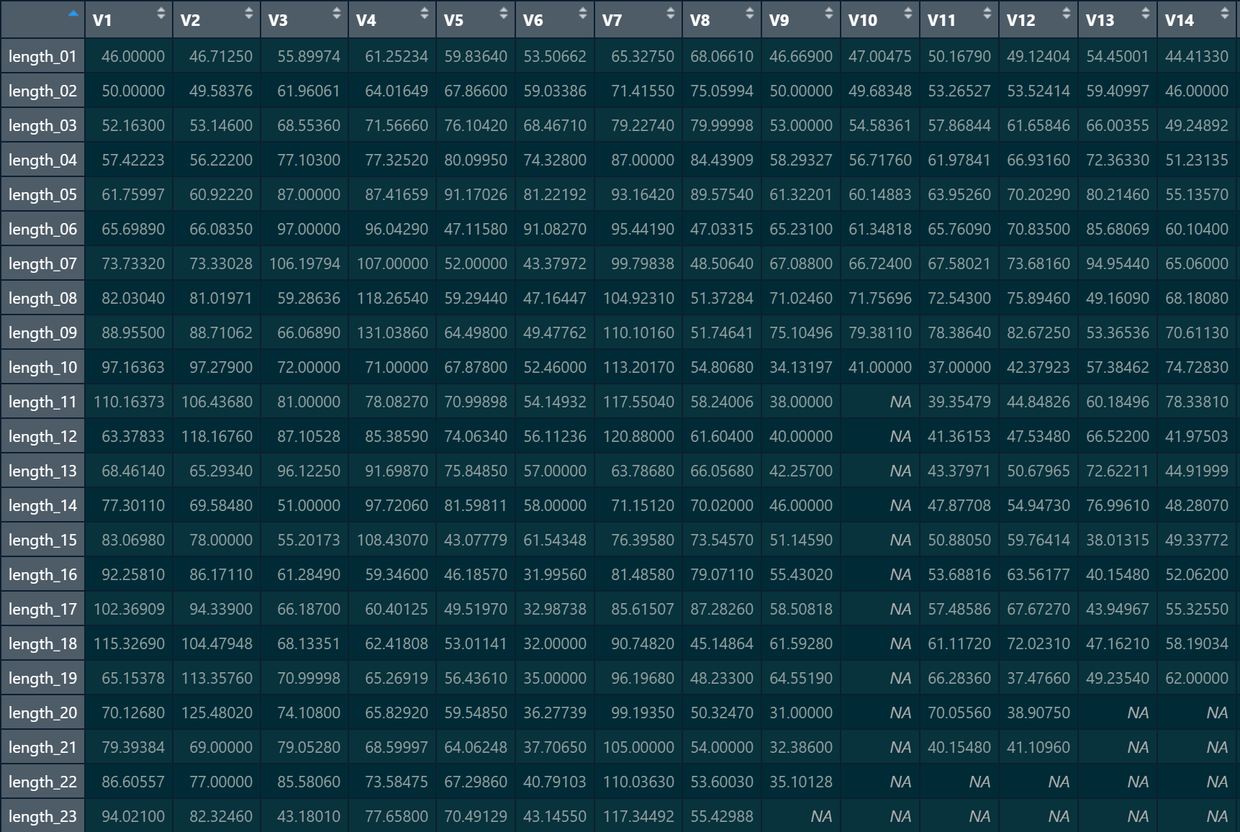
Results – r analysis
This gives us the following data.
Each column is a different cell, each row is a different frame. The values in each cell is the length of that particular cell on that particular frame. Values with ‘NA’ did not have a length as the cell did not exists at that frame – this is important for later!

Slide 16
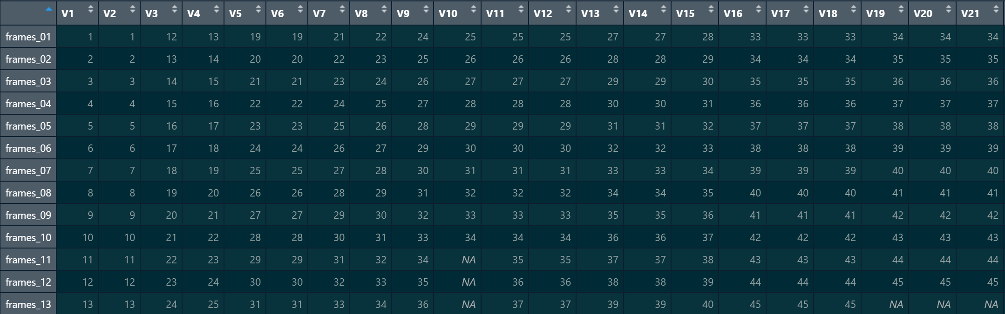
Results – r analysis
We duplicate this process for the variable ‘frames’. This represents which frame/s the cell exists on. This is also an important stage!

Slide 17
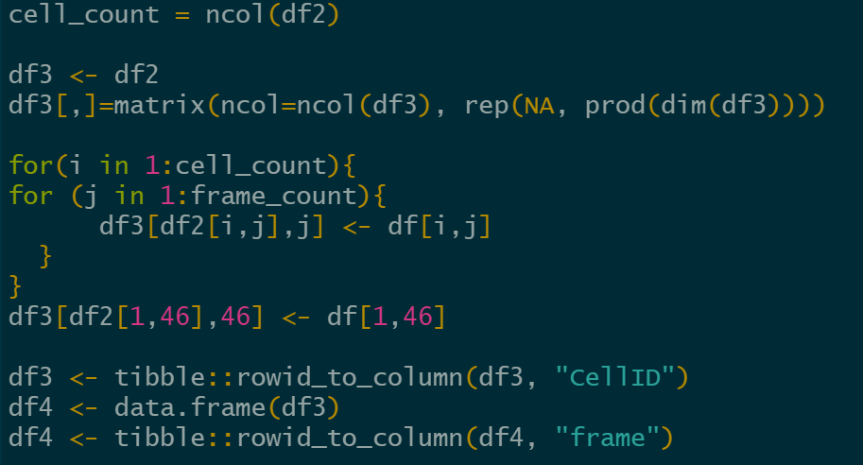
Results – r analysis
The values in the ‘frames’ data.frame represent which frames that cell exists on. This is used to modify the layout of the ‘lengths’ to match which frame a cell had that length on.
So all we do is iterate through each cell, and each frame, and adjust the position of the length to match the frame it should appear on.

Slide 18
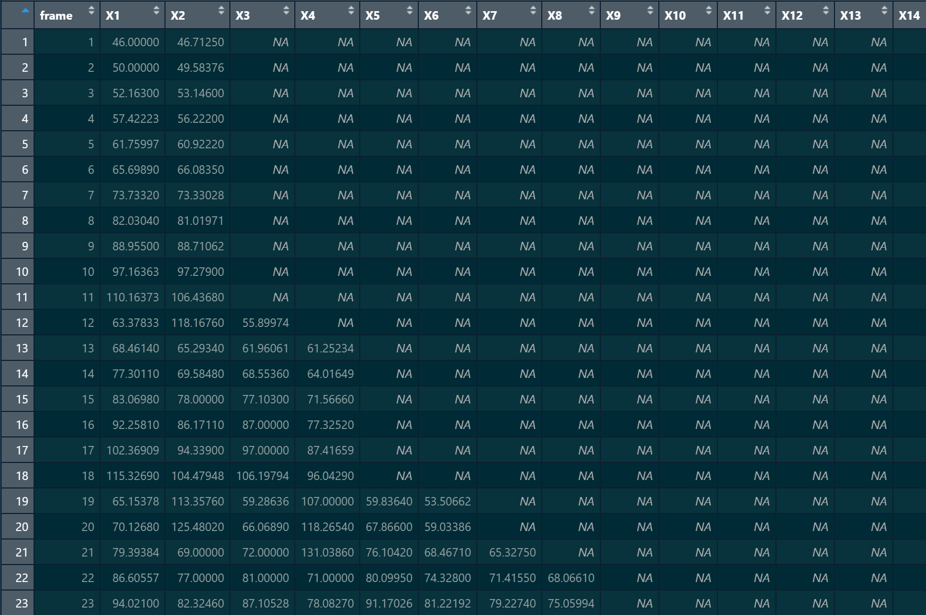
Results – r analysis
Which produces this! All of the lengths are in the correct frame that they should be in.

Slide 19
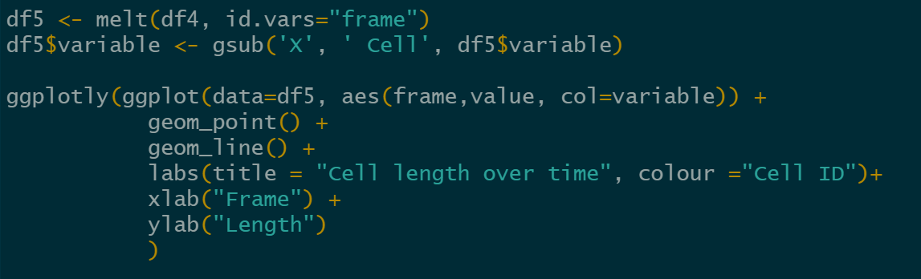
Results – r analysis
Visualising the lengths of a cell over time is done by first melting the sorted data.frame by collapsing the data based on the ‘frame’ column.
We then plot the data, with the X axis being the frame and the Y being the length.

Slide 20
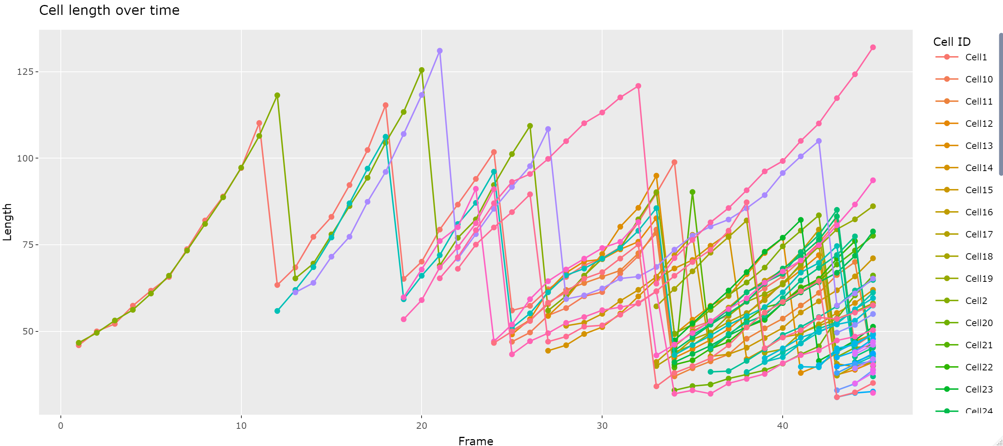
Results – r analysis
https://rpubs.com/ConnorS123/982694 <- that should have this plot online for interactive use

Slide 21
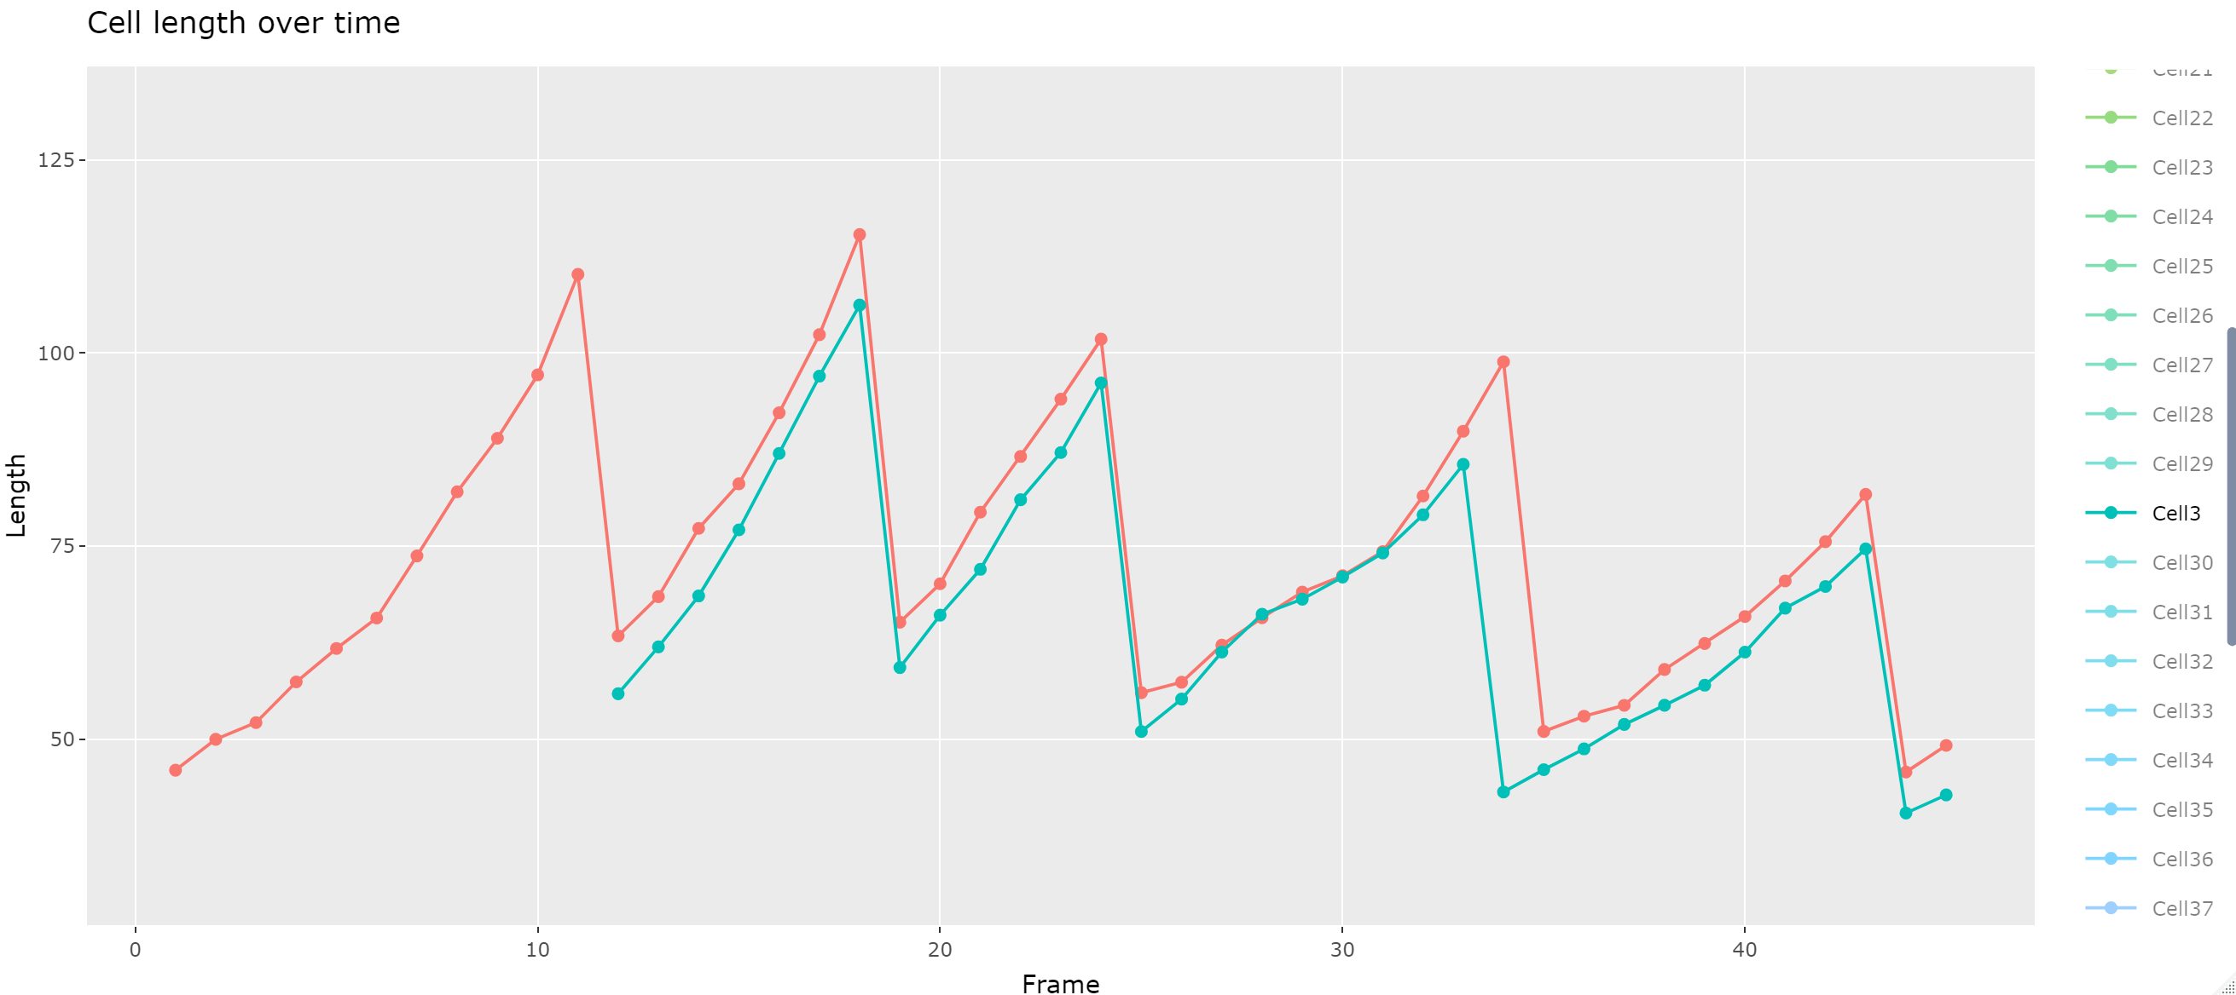
Results – r analysis
A lot going on in that plot. So let’s focus on two cells only: cell 1 and cell 3.
We can see that from frame 1 to frame 12 cell 1 grows in length. Then, at frame 12 the length returns almost to what it originally was. At the same time cell 3 appears and experiences growth on par with cell 1.

Slide 22
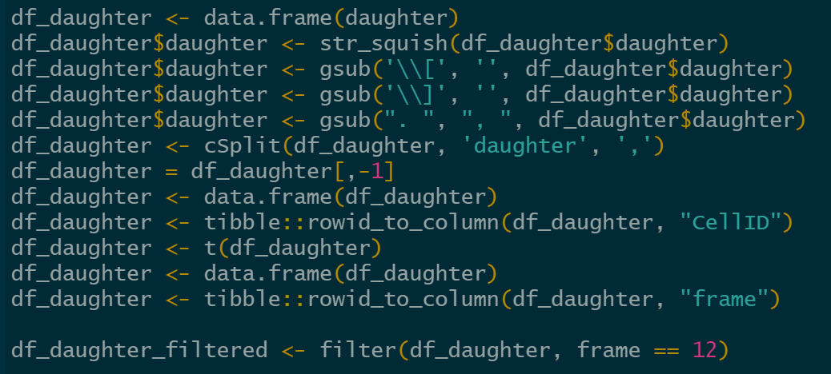
Results – r analysis
We can assume that this means that on frame 12, cell 1 underwent division and produced cell 3. But how to prove that?
We replicate the same tidying up that we did before, though now we simply filter those results based on ‘frame 12’. And see that on frame 12, cell 1 produced cell 3!

Slide 23
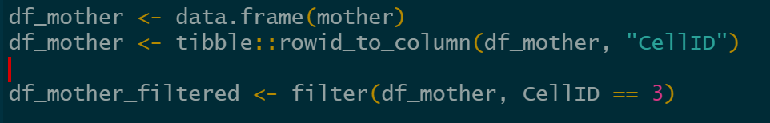
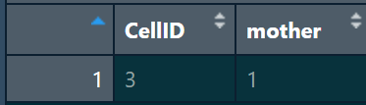
Results – r analysis
Let’s do one additional step to confirm this by checking what the Python program assumed the mother of cell 3 was…
Yep! The mother cell of cell 3 is indeed cell 1!

Slide 24
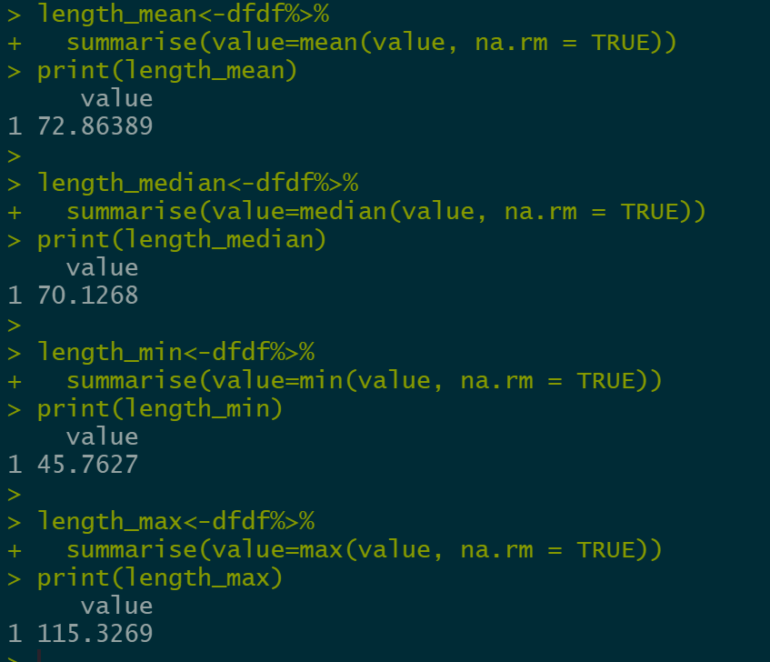
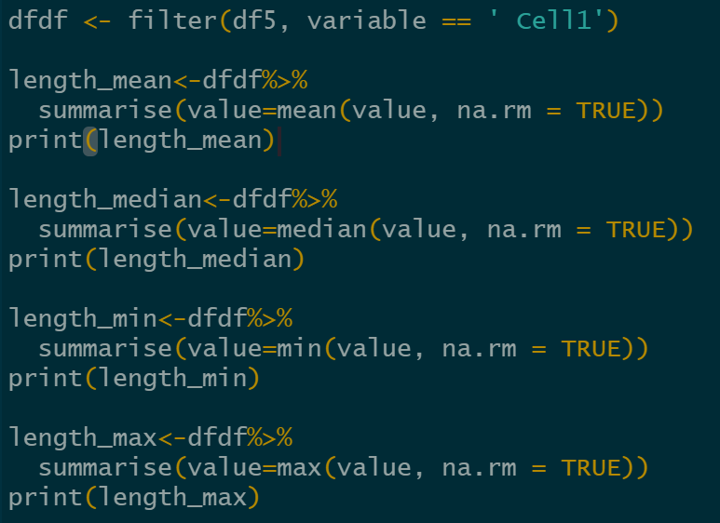
Results – r analysis
If we wanted to get more general statistics for a cell length, such as the mean, median, maximum or minimum lengths we can do.

Slide 25
Results – r analysis
There are quite a few variables we can explore that the Python program generates for each cell: length, width, area, frames it exists on, mother cell, daughter cells, perimeter, center…
Additionally, the Python program allows for fluorescent images to be included in the analysis. So each brightfield image (the standard grey images) would have an additional accompanying image where the cells are exposed to a wavelength that allows for fluorescence.

Slide 26
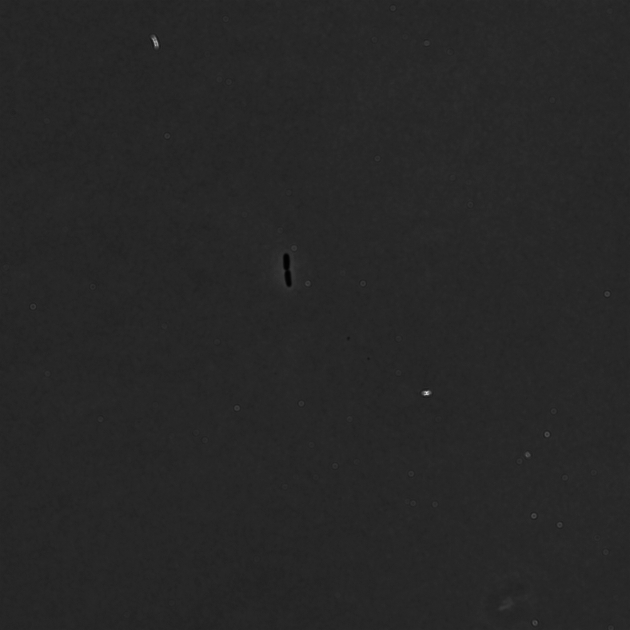
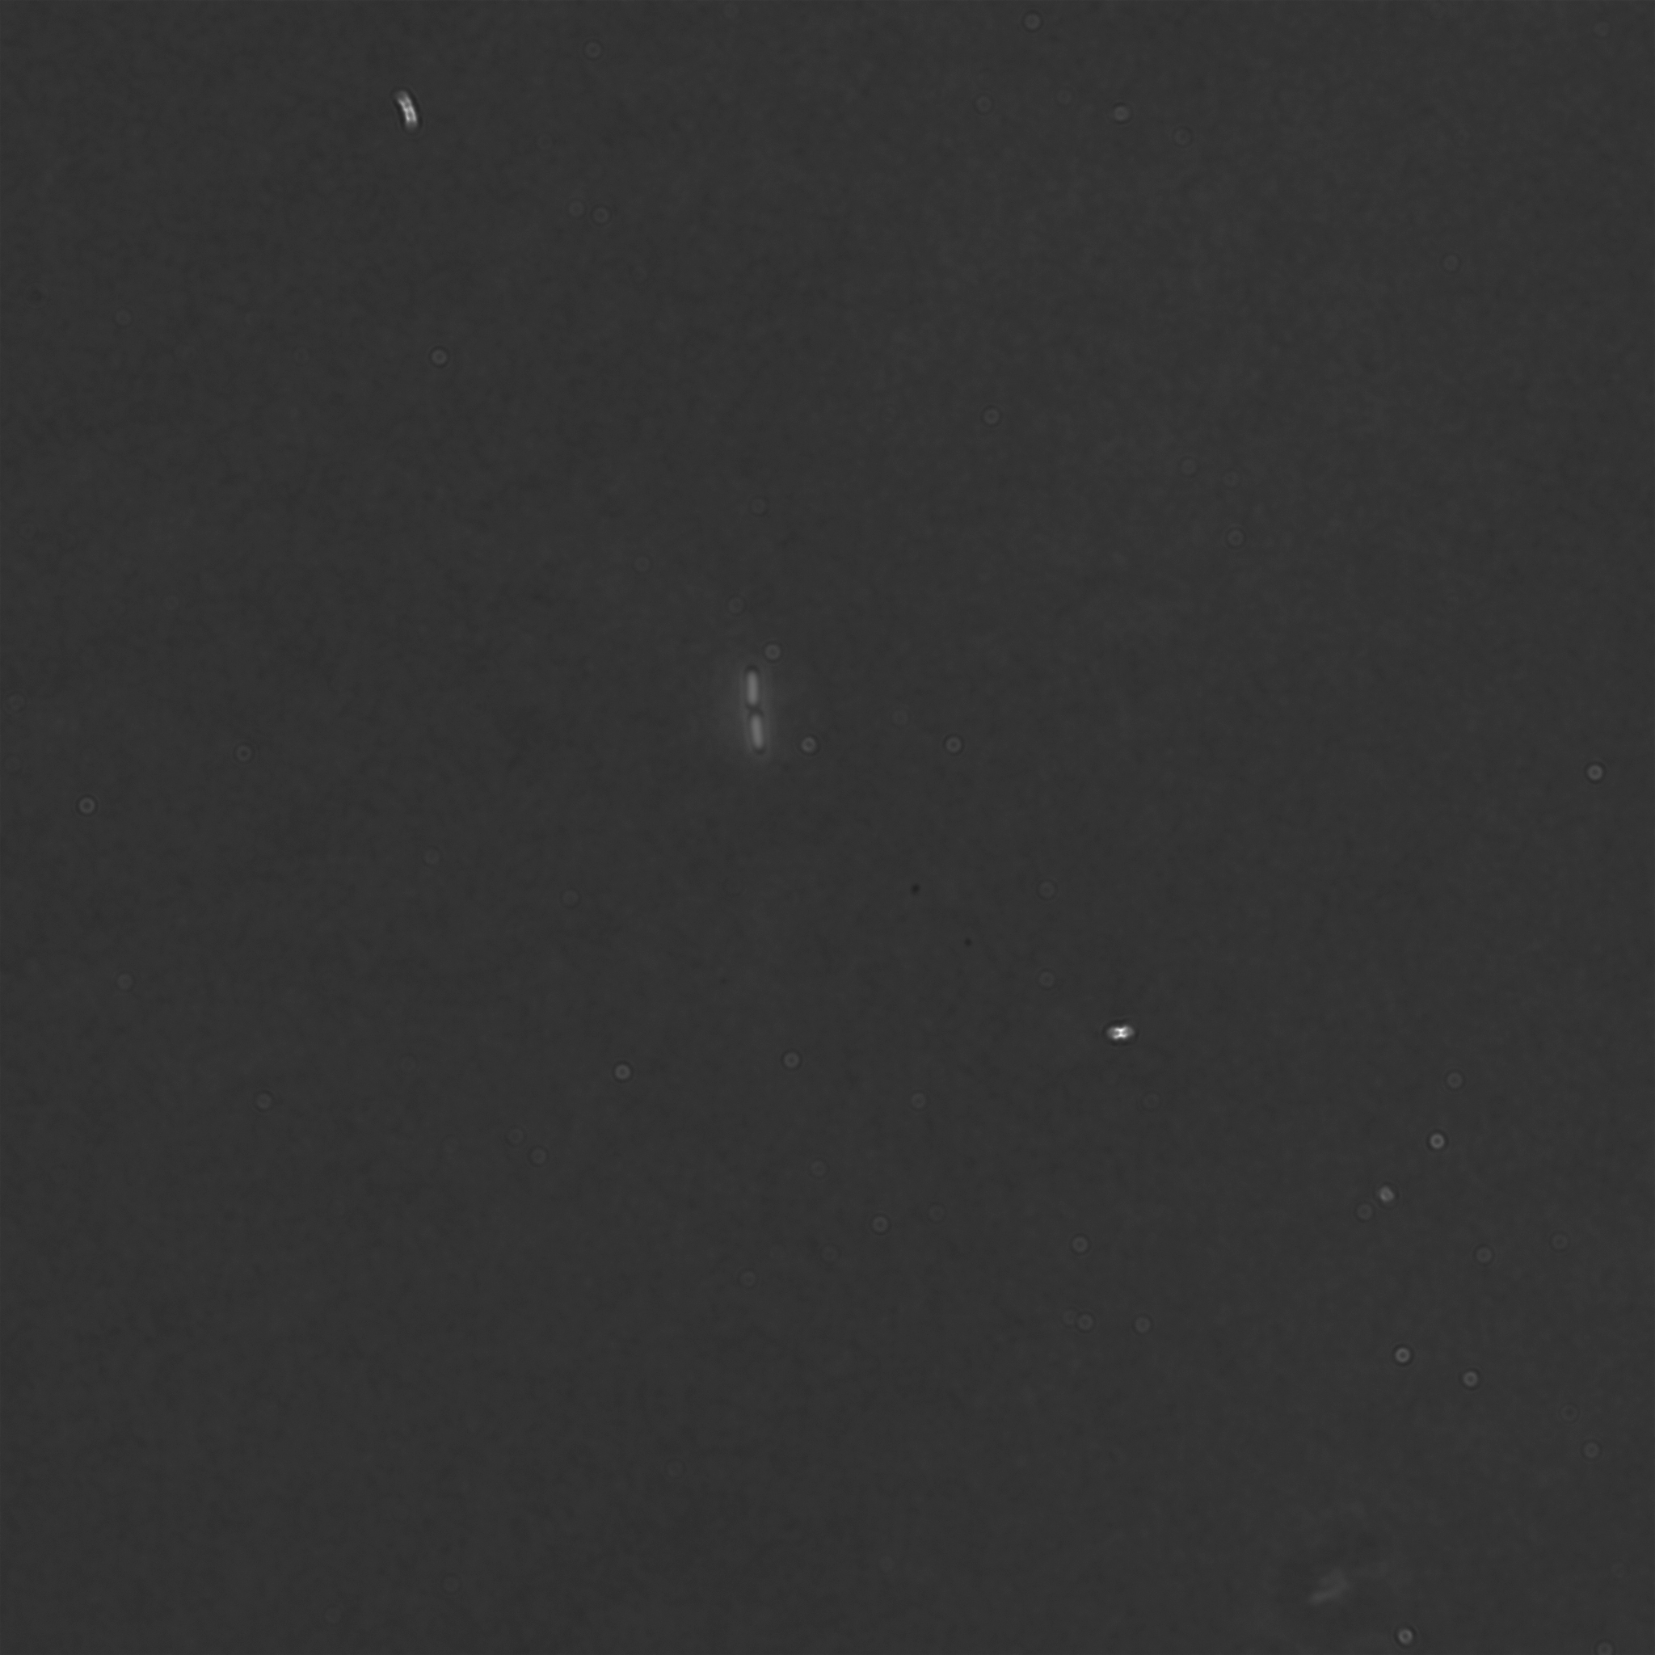
Results – r analysis
Assume that the top-most image is the original brightfield image for frame 1, the bottom is the fluorescence image for that frame.
The program uses the estimated segmentation for each cell to check the corresponding area in the corresponding fluorescence image to then get the average colour in that area.
With this you could check the average colour of a cell over time – maybe it changes when it divides?

